Slide 1
IMS Project presentation
AYUB YUSUF
SDET programme (Software development engineer in test)

Slide 2
Project Objective
IMS project:
Build an application which interacts with a managed database
The application must use supporting tools, methodologies and technologies that encapsulates all modules covered during training

Slide 3
Technologies used
• Version Control System: Git
• Source Code Management: GitHub
• Kanban Board: Jira
• Database Management System: MySQL
• Back-End Programming Language: Java
• Build Tool: Maven
• Unit Testing: JUnit

Slide 4
Scope
A risk assessment which outlines the issues and risks faced during the project timeframe
Code fully integrated into a Version Control System
A project management board
A relational database used to persist data for the project
A functional application back-end
A build of the application
Unit tests for validation of the application

Slide 5
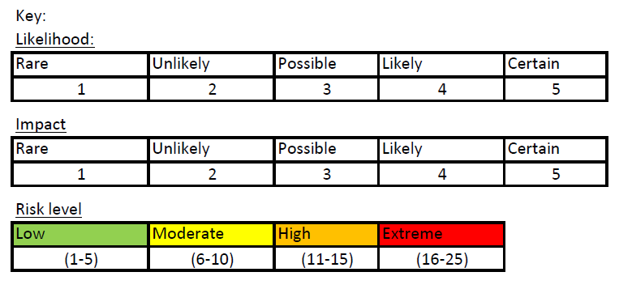
Risk Assessment

Slide 6
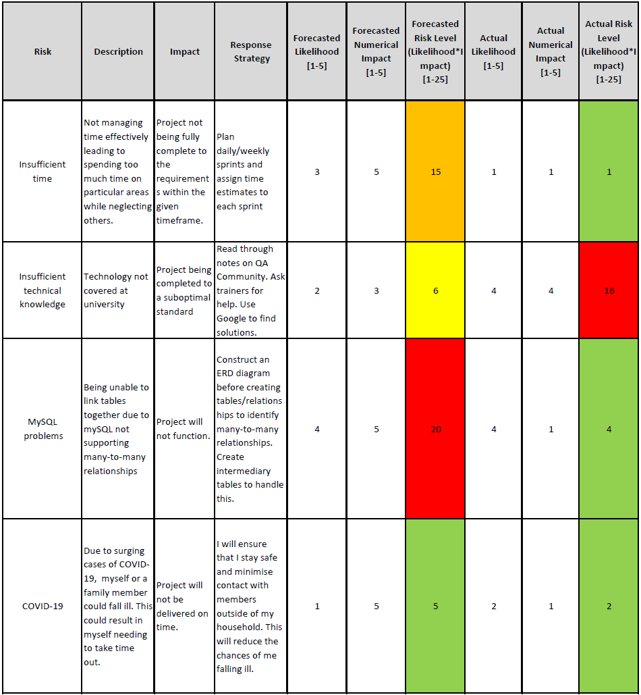
Risk Assessment

Slide 7
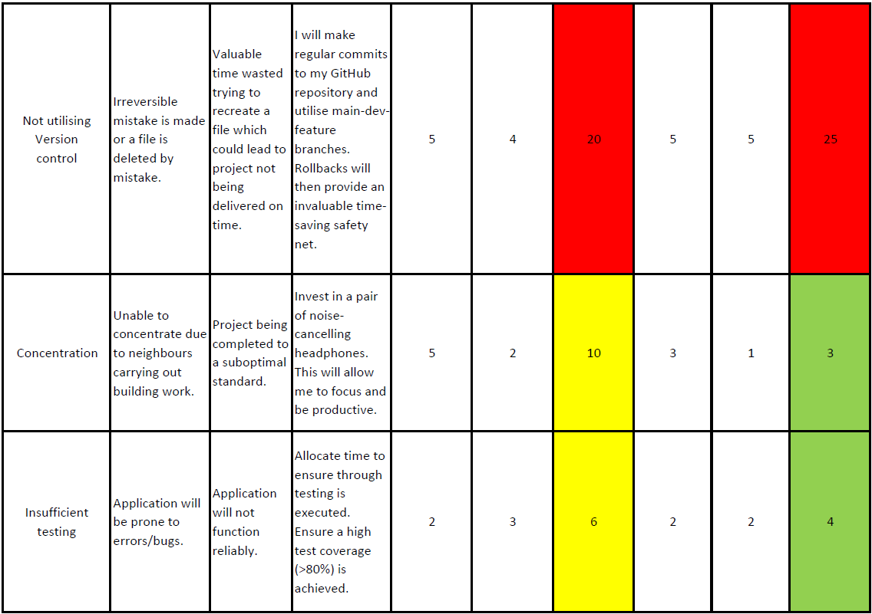
Risk Assessment

Slide 8
Scope
A risk assessment which outlines the issues and risks faced during the project timeframe
Code fully integrated into a Version Control System
A project management board
A relational database used to persist data for the project
A functional application back-end
A build of the application
Unit tests for validation of the application

Slide 9
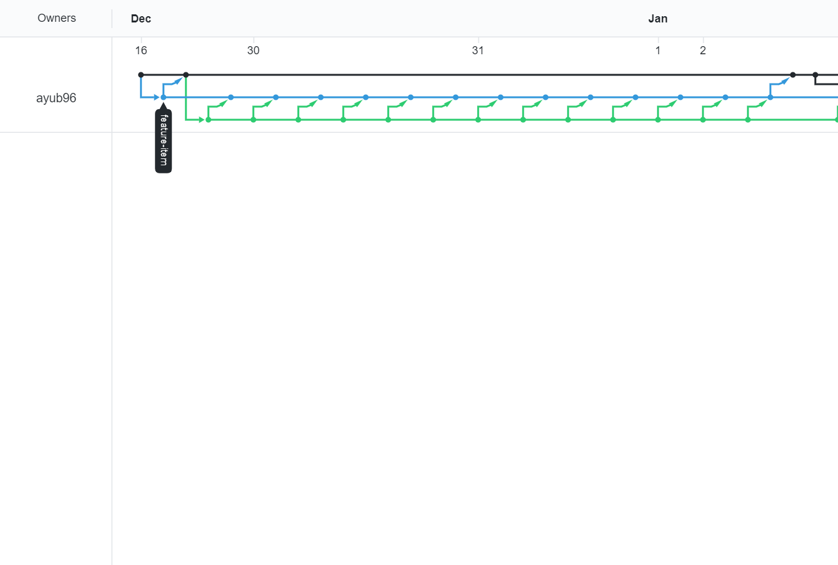
Version control system: Git
Main branch
Developer branch
Feature CRUD branch
feature-branch model: master/dev/multiple features

Slide 10
CI Pipeline
Source Code
Version Control System
Project Tracking
Java
Git/Github
Jira
Build Tool
Maven
Database Server
Automated Testing
MySQL
JUnit, Mockito

Slide 11
Scope
A risk assessment which outlines the issues and risks faced during the project timeframe
Code fully integrated into a Version Control System
A project management board
A relational database used to persist data for the project
A functional application back-end
A build of the application
Unit tests for validation of the application

Slide 12
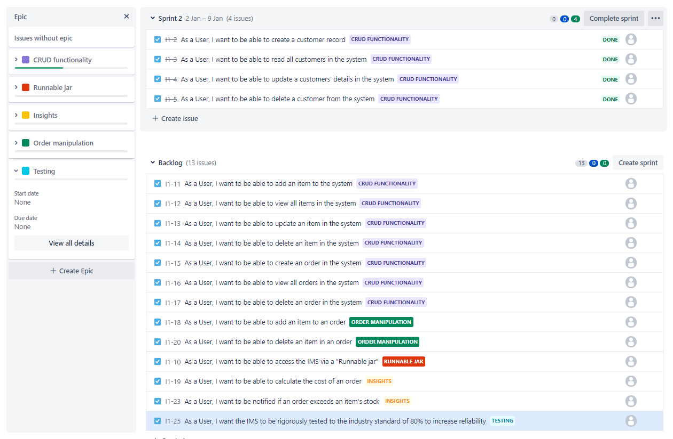
Project management board: Kanban
To effectively manage my project, an Agile approach was adopted.
A Kanban board (a feature of Jira) was used to manage the project.
The first step of the planning was to add an exhaustive list of user stories to the backlog.

Slide 13
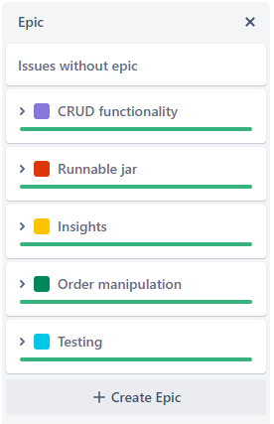
Project management board: Kanban
The following epics were created:
CRUD functionality
Runnable jar
Insights
Order manipulation
Testing
All epics were successfully completed

Slide 14
Sprint review
Most of the Sprints were completed successfully, though some were left behind due to difficulty or lack of time:
Customer email
Orderline feature:
Multiple items with the same id can be contained in one line in an order

Slide 15
Scope
A risk assessment which outlines the issues and risks faced during the project timeframe
Code fully integrated into a Version Control System
A project management board
A relational database used to persist data for the project
A functional application back-end
A build of the application
Unit tests for validation of the application

Slide 16
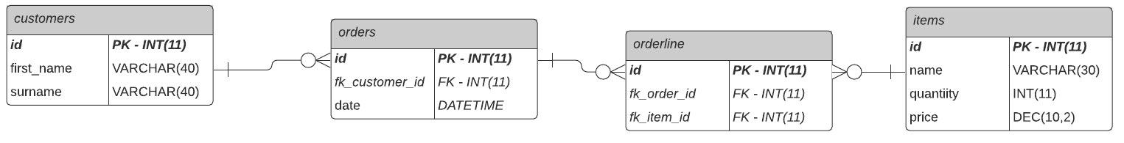
Relational database: MySQL
A relational database (used to persist data for the project) was created using MySQL
The above ERD diagram was implemented in the relational database
An intermediary orderline table was created because mySQL does not support many-to-many relationships

Slide 17
Scope
A risk assessment which outlines the issues and risks faced during the project timeframe
Code fully integrated into a Version Control System
A project management board
A relational database used to persist data for the project
A functional application back-end
A build of the application
Unit tests for validation of the application

Slide 18
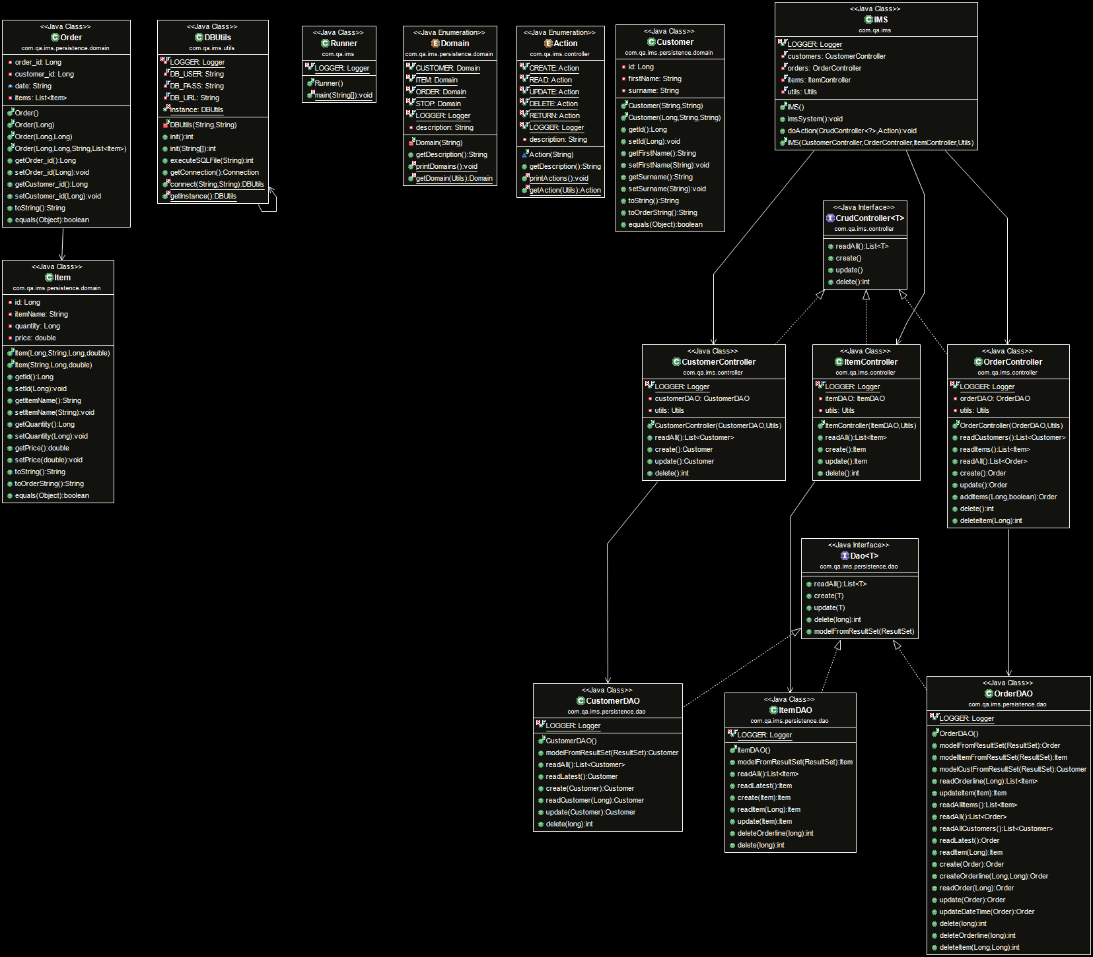
Back-end: UML diagram
Good practices and design principles were followed:
ObjectControllers only instantiate their own ObjectDAO
ObjectControllers do not instantiate other ObjectControllers
DAOs do not instantiate other DAOs
Notes:
- Highlight the fact that the IMS speaks to the CrudController interface

Slide 19
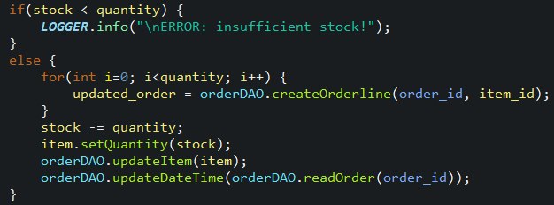
Extra features
When updating an order, the following extra features have been implemented:
Stock:
An item is not added to an order if the quantity required exceeds the item stock
DateTime:
Each time an item is added to or deleted from an order, the date and time for that order is updated

Slide 20
Scope
A risk assessment which outlines the issues and risks faced during the project timeframe
Code fully integrated into a Version Control System
A project management board
A relational database used to persist data for the project
A functional application back-end
A build of the application
Unit tests for validation of the application

Slide 21
Build of application: Maven
The application was built using the build tool Maven.
I will now demonstrate the following user stories in the application:
As a user, I want to create an order
As a user, I want to add an item to an order
As a user, I want to delete an item from an order

Slide 22
Scope
A risk assessment which outlines the issues and risks faced during the project timeframe
Code fully integrated into a Version Control System
A project management board
A relational database used to persist data for the project
A functional application back-end
A build of the application
Unit tests for validation of the application

Slide 23
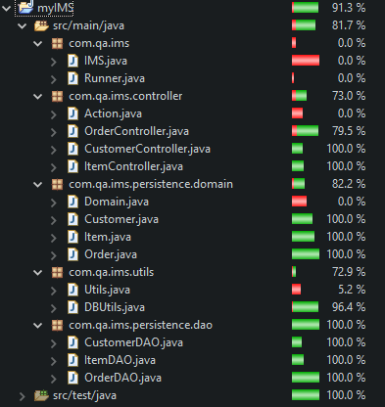
Testing: Coverage
A coverage of 81.7% was achieved.
101/101 Tests ran successfully
The following Tests files were created:
Controllers:
CustomerControllerTest.java
ItemControllerTest.java
OrderControllerTest.java
DAOs:
CustomerDAOTest.java
ItemDAOTest.java
OrderDAOTest.java
CustomerDAOTestFAIL.java
ItemDAOTestFAIL.java
OrderDAOTestFAIL.java
Domain:
CustomerTest.java
CustomerEqualsTest.java
ItemTest.java
ItemEqualsTest.java
OrderTest.java
OrderEqualsTest.java
Notes:
Talk about why you did FAIL tests
Talk about Equals tests

Slide 24
Conclusion
Better commits should be used, eg “feature-customer-crud”
Commits should be made regularly to avoid dumping lots of changes in one go
User stories should continuously be added to the backlog throughout the project timeline so it is clear what is left to be done when new user stories surface

Slide 25
Questions?

